Slide 1
Node. JS
Instructor: Prof. Vijayetha

Slide 2
Node.js is an open-source server side runtime environment built on Chrome's V8 JavaScript engine.
It provides an event driven, non-blocking (asynchronous) I/O and cross-platform runtime environment for building highly scalable server-side application using JavaScript.
Node.js can be used to build different types of applications such as command line application, web application, real-time chat application, REST API server etc.
However, it is mainly used to build network programs like web servers, similar to PHP, Java, or ASP.NET.

Slide 3
Advantages
Node.js is an open-source framework under MIT license. Uses JavaScript to build entire server side application.
Lightweight framework that includes bare minimum modules. Other modules can be included as per the need of an application.
Asynchronous by default. So it performs faster than other frameworks.
Cross-platform framework that runs on Windows, MAC or Linux

Slide 4
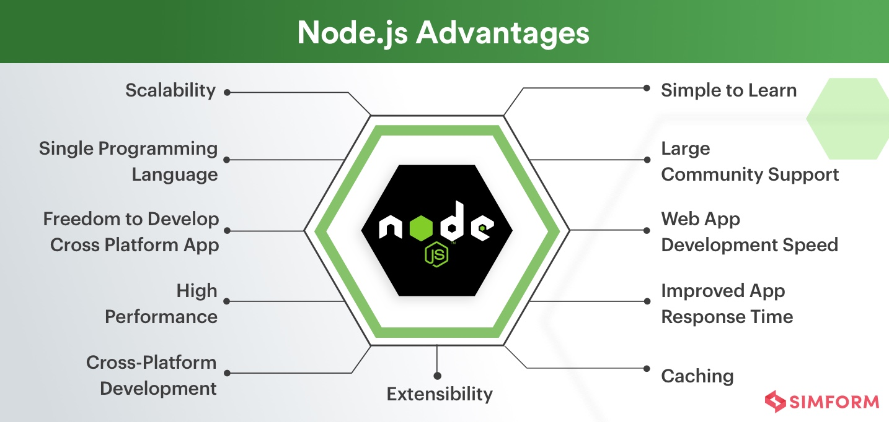

Slide 5
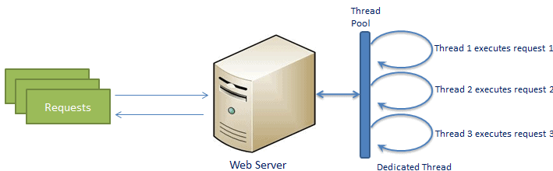
Traditional Web Server Model

Slide 6
Each request is handled by a dedicated thread from the thread pool.
If no thread is available in the thread pool at any point of time then the request waits till the next available thread.
Dedicated thread executes a particular request and does not return to thread pool until it completes the execution and returns a response.

Slide 7
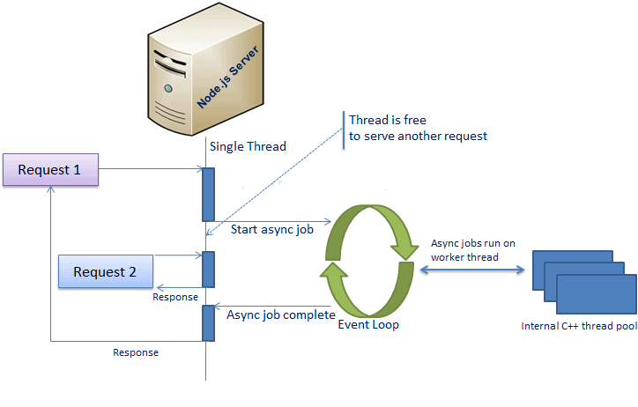
Node.JS process model

Slide 8
Node.js runs in a single process and the application code runs in a single thread and thereby needs less resources than other platforms.
All the user requests to your web application will be handled by a single thread and all the I/O work or long running job is performed asynchronously for a particular request.
So, this single thread doesn't have to wait for the request to complete and is free to handle the next request.
When asynchronous I/O work completes then it processes the request further and sends the response.
An event loop is constantly watching for the events to be raised for an asynchronous job and executing callback function when the job completes.

Slide 9
Differences between browser and Node JS
Both the browser and Node.js use JavaScript as their programming language.
From the perspective of a frontend developer who extensively uses JavaScript, Node.js apps bring with them a huge advantage: the comfort of programming everything - the frontend and the backend - in a single language.
In the browser, most of the time what you are doing is interacting with the DOM, or other Web Platform APIs like Cookies. You don't have the document, window and all the other objects that are provided by the browser in Node.
And in the browser, we don't have all the nice APIs that Node.js provides through its modules, like the filesystem access functionality.

Slide 10
Installation
Visit Node.js official web site https://nodejs.org. It will automatically detect OS and display download link as per your Operating System.
After you download the MSI, double-click on it to start the installation as shown below.
To Install Node.js on Mac/Linux, Visit Node.js official web site https://nodejs.org/en/download page. Click on the appropriate installer for Mac (.pkg or .tar.gz) or Linux to download the Node.js installer.
To test the successful installation, open cmd, type node –v
(Check the cmd screenshot posted in next slide)

Slide 11
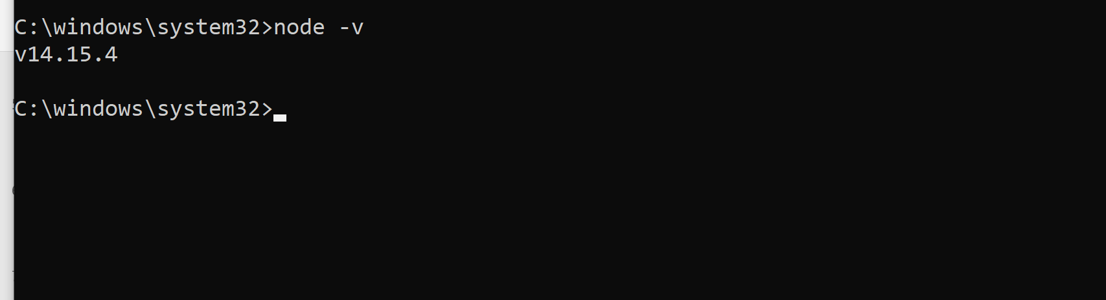

Slide 12
Node JS console
Node.js comes with virtual environment called REPL (aka Node shell). REPL stands for Read-Eval-Print-Loop. It is a quick and easy way to test simple Node.js/JavaScript code.
To launch the REPL (Node shell), open command prompt (in Windows) or terminal (in Mac or UNIX/Linux) and type node as shown below. It will change the prompt to > in Windows and MAC.
I have attached screenshot in the next slide with certain expressions and functions

Slide 13
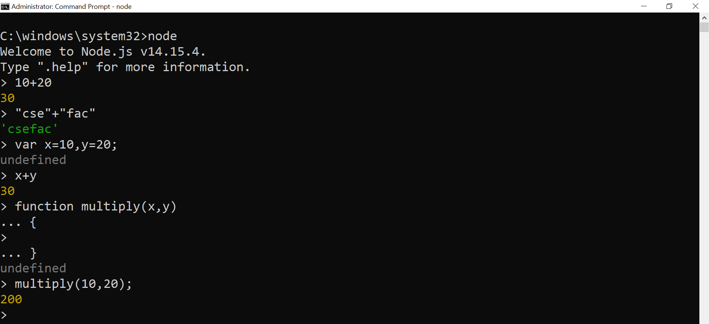

Slide 14
Datatypes
String
Number
Boolean
Undefined
Null
RegExp
Everything else is an object in Node.js.
var obj = {
authorName: 'Ryan Dahl',
language: 'Node.js'
}

Slide 15
Functions
function Display(x) {
console.log(x);
}
Display(100);

Slide 16
Buffer
Node.js includes an additional data type called Buffer (not available in browser's JavaScript). Buffer is mainly used to store binary data, while reading from a file or receiving packets over the network.
process object
Each Node.js script runs in a process. It includes process object to get all the information about the current process of Node.js application.
Access Global Scope
In a browser, global scope is the window object. In Node.js, global object represents the global scope.
To add something in global scope, you need to export it using export or module.export. The same way, import modules/object using require() function to access it from the global scope.
For example, to export an object in Node.js, use exports.name = object.

Slide 17
Story about require, modules, export in Node
Node.js treats each JavaScript file as a separate module.
Each module in Node.js has its own context, so it cannot interfere with other modules or pollute global scope. Also, each module can be placed in a separate .js file under a separate folder.
When a code is written, Node takes the entire code and encloses it within a function wrapper.
The syntax of this function wrapper is:

Slide 18
The entire code written inside a module is private to the module, unless explicitly stated (exported) otherwise.
the variables are scoped locally to the module rather than being scoped globally.
This happens because each module has a function wrapper of its own and the code written inside one function is local to that function and cannot be accessed outside this function.

Slide 19
The five parameters — exports, require, module, __filename, __dirname are available inside each module in Node.
So, the question that arises now is how do you specify something in a module that can be used by some other module? This is when the module, require, export parameters of the function wrapper are helpful.
Practice program- getName

Slide 20
Exporting Multiple Methods and Values
Practice program- name,dob,age

Slide 21
Core modules
http, url, querystring, path, fs, util
In order to use Node.js core or NPM modules, you first need to import it using require() function as shown below.
var module = require('module_name');

Slide 22
Example: http core module
var http = require('http');
var server = http.createServer(function(req, res){
//write code here
res.write('Hello World!'); //write a response to the client res.end(); //end the response
});
server.listen(5000); //the server object listens on port 5000
http module allows Node.js to transfer data over the Hyper Text Transfer Protocol (HTTP).
The HTTP module can create an HTTP server that listens to server ports and gives a response back to the client.

Slide 23
Adding HTTP header
var http = require('http'); http.createServer(function (req, res) { res.writeHead(200, {'Content-Type': 'text/html'}); res.write('Hello World!'); res.end(); }).listen(8080);
If the response from the HTTP server is supposed to be displayed as HTML, include content type as html, 200 is status code

Slide 24
Read the Query String
var http = require('http'); http.createServer(function (req, res) { res.writeHead(200, {'Content-Type': 'text/html'}); res.write(req.url); res.end(); }).listen(8080);
The function passed into the http.createServer() has a req argument that represents the request from the client, as an object (http.IncomingMessage object).
This object has a property called "url" which holds the part of the url that comes after the domain name:

Slide 25
Other core modules
url : Parse an address with the url.parse() method, and it will return a URL object with each part of the address as properties
Fs- read, write, open, append
Look at syntax of all these functions
Practice programs done in class/practical lab sessions

Slide 26
fs module
Read Files
Write Files
Append Files
Close Files
Delete Files
Asynchronous and synchronous read
readFile(file path,callback) readFileSyn(“file path”)
Write file- will overwrite the file
fs.writeFile(path,data,options,callback)
fs.writeFile('sample_http.txt', 'This is node.js', 'utf8',function(err)

Slide 27
writeFile Parameters
path: It is a string, Buffer, URL, or file description integer that denotes the path of the file where it has to be written. Using a file descriptor will make it behave similarly to fs.write() method.
data: It is a string, Buffer, TypedArray, or DataView that will be written to the file.
options: It is a string or object that can be used to specify optional parameters that will affect the output. It has three optional parameters:
encoding: It is a string value that specifies the encoding of the file. The default value is ‘utf8’.
mode: It is an integer value that specifies the file mode. The default value is 0o666.
flag: It is a string value that specifies the flag used while writing to the file. The default value is ‘w’.
callback: It is the function that would be called when the method is executed.
err: It is an error that would be thrown if the operation fails.

Slide 28
Appending to file
fs.appendFile('sample_http.txt', data, 'utf8', function(err)

Slide 29
fs open
The fs.open() method is used to create, read, or write a file.
The fs.readFile() method is only for reading the file and fs.writeFile() method is only for writing to the file,
whereas fs.open() method does several operations on a file
fs.open(path, flags, mode, callback)

Slide 30
path: It holds the name of the file to read or the entire path if stored at other locations.
flags: Flags indicate the behavior of the file to be opened. All possible values are ( r, r+, rs, rs+, w, wx, w+, wx+, a, ax, a+, ax+).
mode: Sets the mode of file i.e. r-read, w-write, r+ -readwrite. It sets to default as readwrite.
callback:
It is a callback function that is called after reading a file. It takes two parameters: err,data

Slide 31
Fs read
fs.read(fd, buffer, offset, length, position, callback)
Parameters:
fd: This is the file descriptor returned by fs.open() method.
buffer: This is the buffer that the data will be written to.
offset: This is the offset in the buffer to start writing at.
length: This is an integer specifying the number of bytes to read.
position: This is an integer specifying where to begin reading from in the file. If the position is null, data will be read from the current file position.
callback: It is a callback function that is called after reading of the file. It takes two parameters:
err: If any error occurs.
data: Contents of the file.

Slide 32
Npm module
Node Package Manager (NPM) is a command line tool that installs, updates or uninstalls Node.js packages in your application.
It is also an online repository for open-source Node.js packages
Packages can be installed either globally or locally
Npm is installed along with node.js
To check for npm installation
Run npm -v

Slide 33
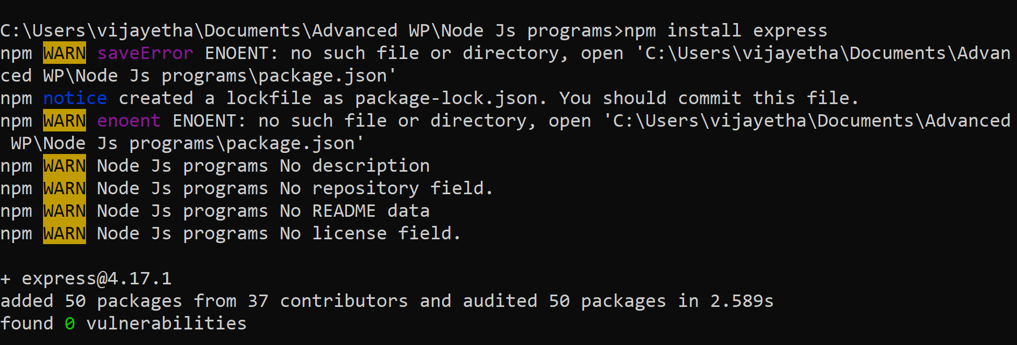
Install packages locally
For example, here I am installing package express

Slide 34
Uninstall
Npm unistall express

Slide 35
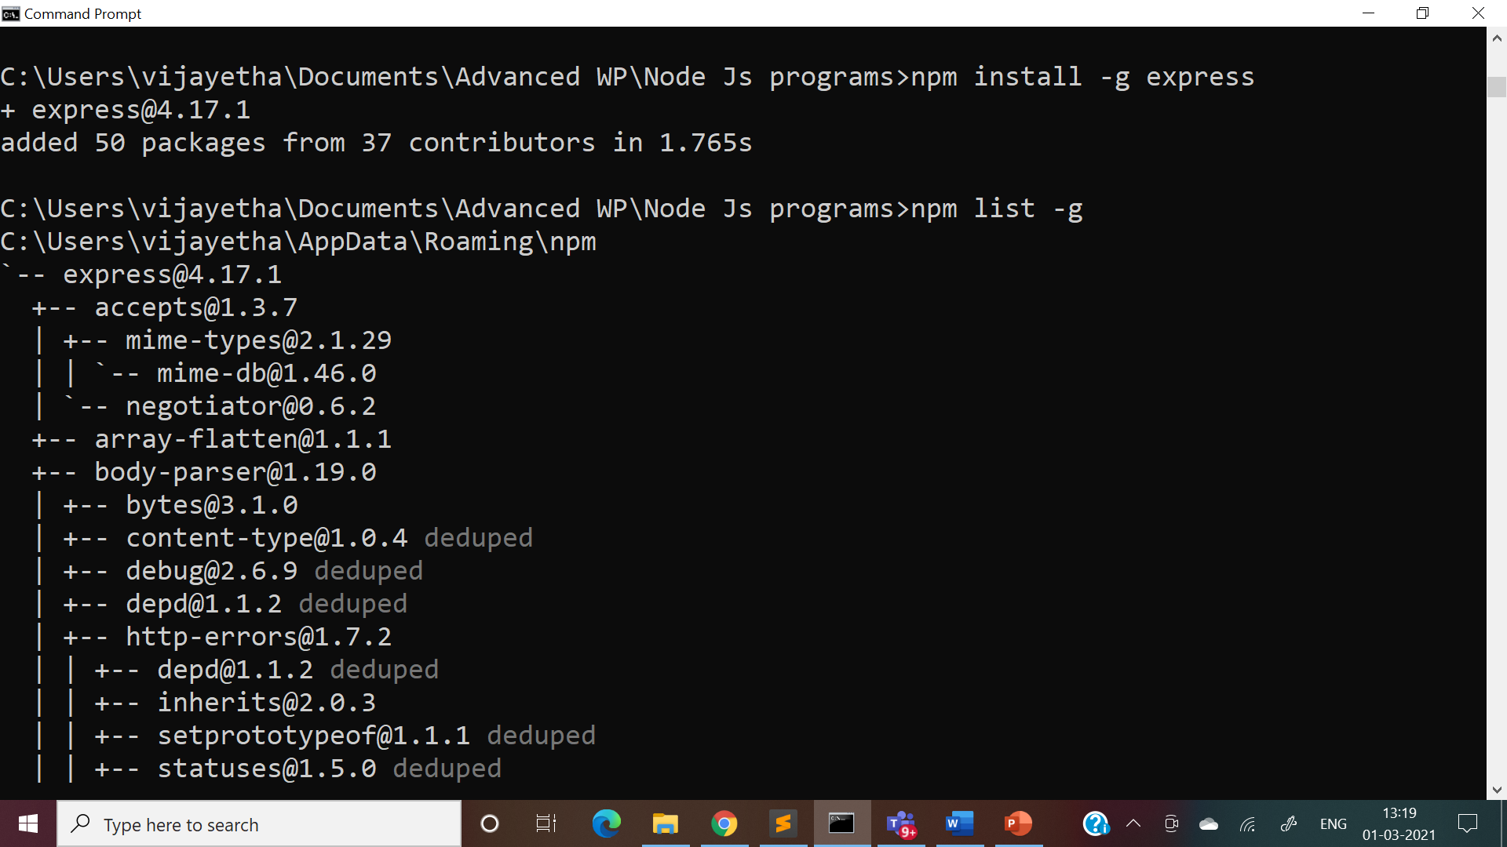
Install globally and list them

Slide 36
Node.js EventEmitter
Node.js allows us to create and handle custom events easily by using events module.
Event module includes EventEmitter class which can be used to raise and handle custom events.
To include the built-in Events module use the require(‘events’) method.
In addition, all event properties and methods are an instance of an EventEmitter object.
To be able to access these properties and methods, create an EventEmitter object:

Slide 37
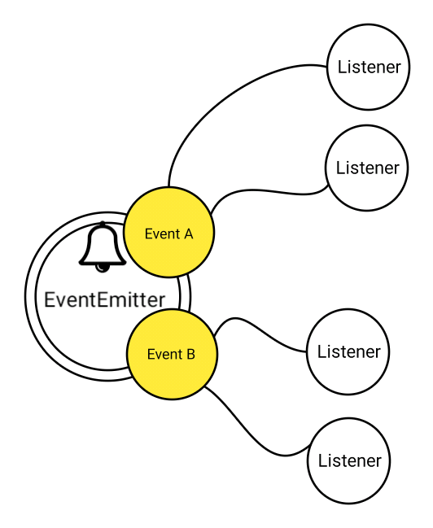
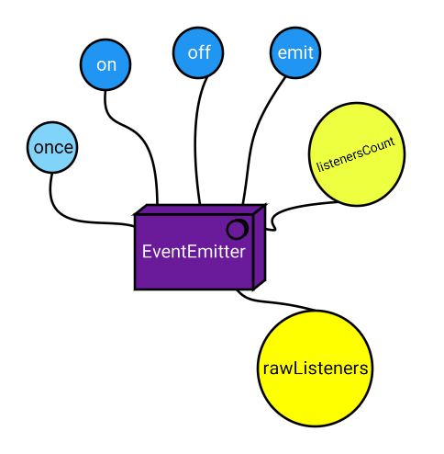

Slide 38
Example
// get the reference of EventEmitter class of events module
var events = require('events');
//create an object of EventEmitter class by using above reference
var em = new events.EventEmitter();
//Subscribe for FirstEvent
em.on('FirstEvent', function (data) {
console.log('First subscriber: ' + data);
});
// Raising FirstEvent
em.emit('FirstEvent', 'This is my first Node.js event emitter example.');

Slide 39
Guess the output
var events = require('events');
//create an object of EventEmitter class by using above reference
var em = new events.EventEmitter();
//Subscribe for FirstEvent
em.on('FirstEvent', function (data) {
console.log('First subscriber: ' + data);
});
em.on('FirstEvent', function (data) {
console.log('Second subscriber: ' + data);
});
// Raising Event
em.emit('FirstEvent', 'This is my first Node.js event emitter example.');
em.emit('FirstEvent', 'This is my Second Node.js event emitter example.');

Slide 40
Registering for the event to be fired only one time using once.
em.once('NewEvent',function(data)
{
console.log(data);
});
em.emit('NewEvent',"my new event");
em.emit('NewEvent',"my new event"); //This will have no effect

Slide 41
em.on('status',function (code, msg)
{
console.log('Got'+code+msg);
});
em.emit('status',200,'OK');

